Slide 1
Climate Insights: Unveiling Ocean-Sea Dynamics, Pandemic Pollution, and Urban Air Trends
August 28, 2023
Jessica Andras
Jennifer Alvarez
Natalia Lopez
Mavin Gill
Fidel Carrillo

Slide 2
Agenda
Intro
Our Oceans - Sea Level Rise
Our Oceans - Temperature Changes
Air Quality - Air Pollution
Dashboard

Slide 3
Introduction
Analyzing the relationship between ocean temperatures and sea level rise throughout the past century.
Investigating the impact of COVID-19 lockdowns on regional air pollution levels.

Slide 4
System Architecture
Global_AP_Nat.js
FinalIndex.html
co2script_NL.js
API calls
script_MG.js
Algorithm Alchemists
SQL
styles_merged_MG_NL.css
pgAdmin
Jupyter notebook

Slide 5
Our Oceans

Slide 6
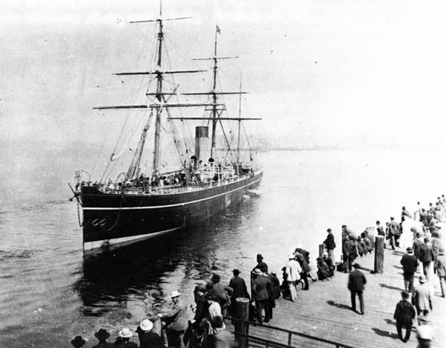
Historical Sea Level Rise
Initial measurements were limited, but advancements in technology and monitoring have allowed for more accurate data collection.
Contributing factors include:
Thermal expansion of seawater due to rising temperatures
Melting of glaciers and ice caps, particularly from the Greenland and Antarctic ice sheets.
View Chart: ‘Global Historical Rise in Sea Level’
Notes:
Since 1880, comprehensive records indicate a consistent increase in global sea levels.
Coastal erosion, flooding, and damage to infrastructure are direct consequences of rising sea levels.
Threats to biodiversity and human populations in low-lying areas.

Slide 7
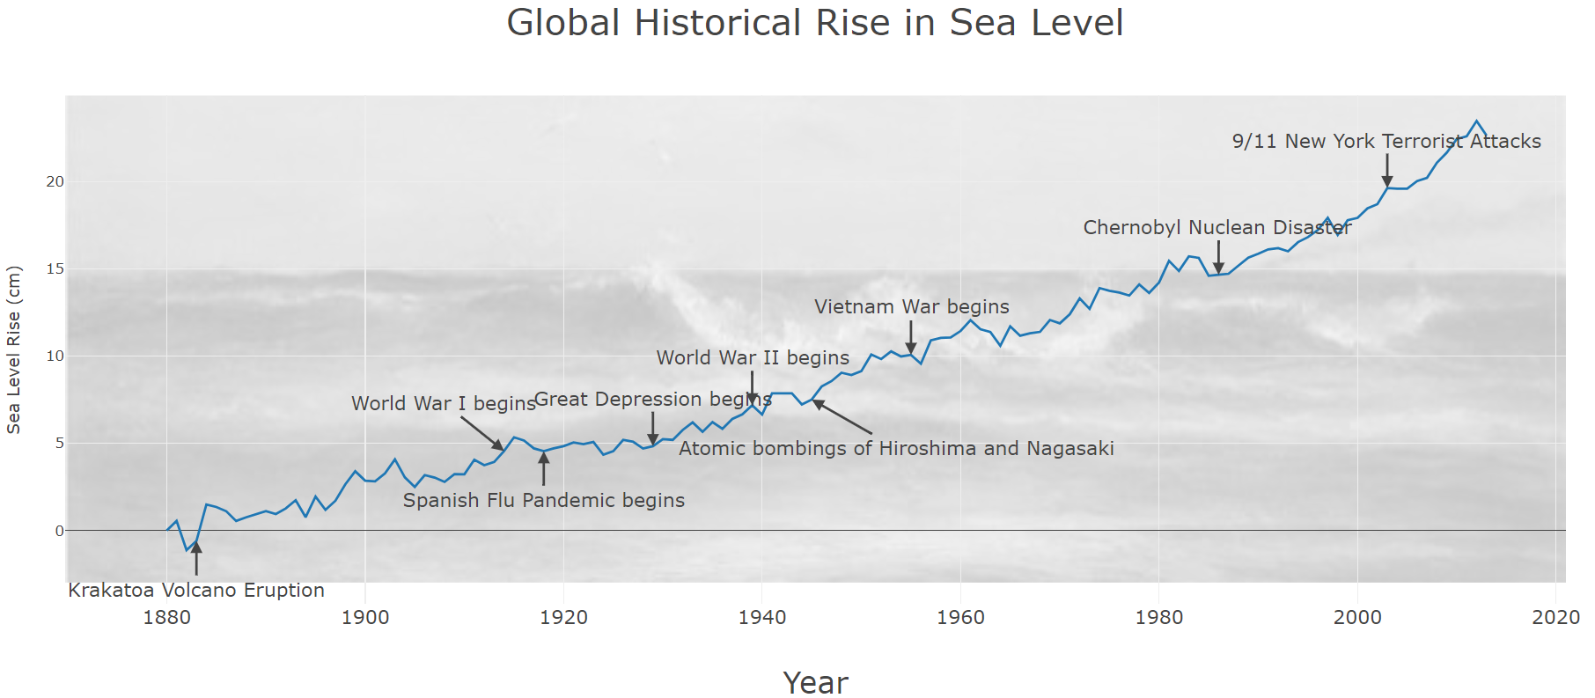
Historical Sea Level Rise
While the trend has been steady, sea level rise has accelerated in recent decades due to increased global warming.
Factors: Growing population, industrialization & greater use of fossil fuels.
Source: EPA.gov
Notes:
Since 1880, comprehensive records indicate a consistent increase in global sea levels.
Coastal erosion, flooding, and damage to infrastructure are direct consequences of rising sea levels.
Threats to biodiversity and human populations in low-lying areas.

Slide 8
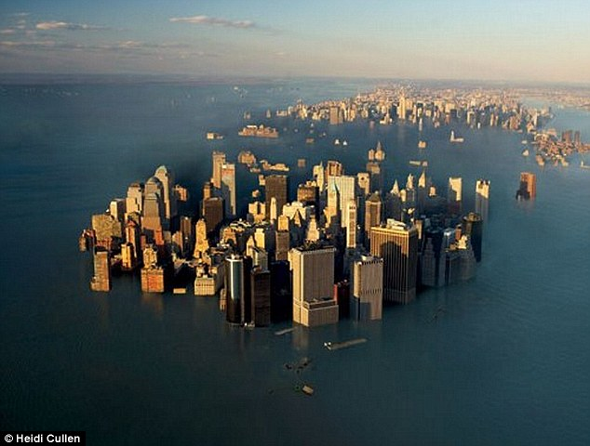
Predicted Sea Level Rise
Urban centers like New York, Sydney, and Miami Beach are particularly vulnerable to the impacts of sea level rise due to their coastal locations and dense populations.
Cities built on low-lying coastal areas experience a higher risk of inundation.
Urban development and the extraction of groundwater can cause land subsidence, exacerbating the effects of sea level rise.
View Chart: ‘Cumulative Predicted rise in Sea Level over Time’

Slide 9
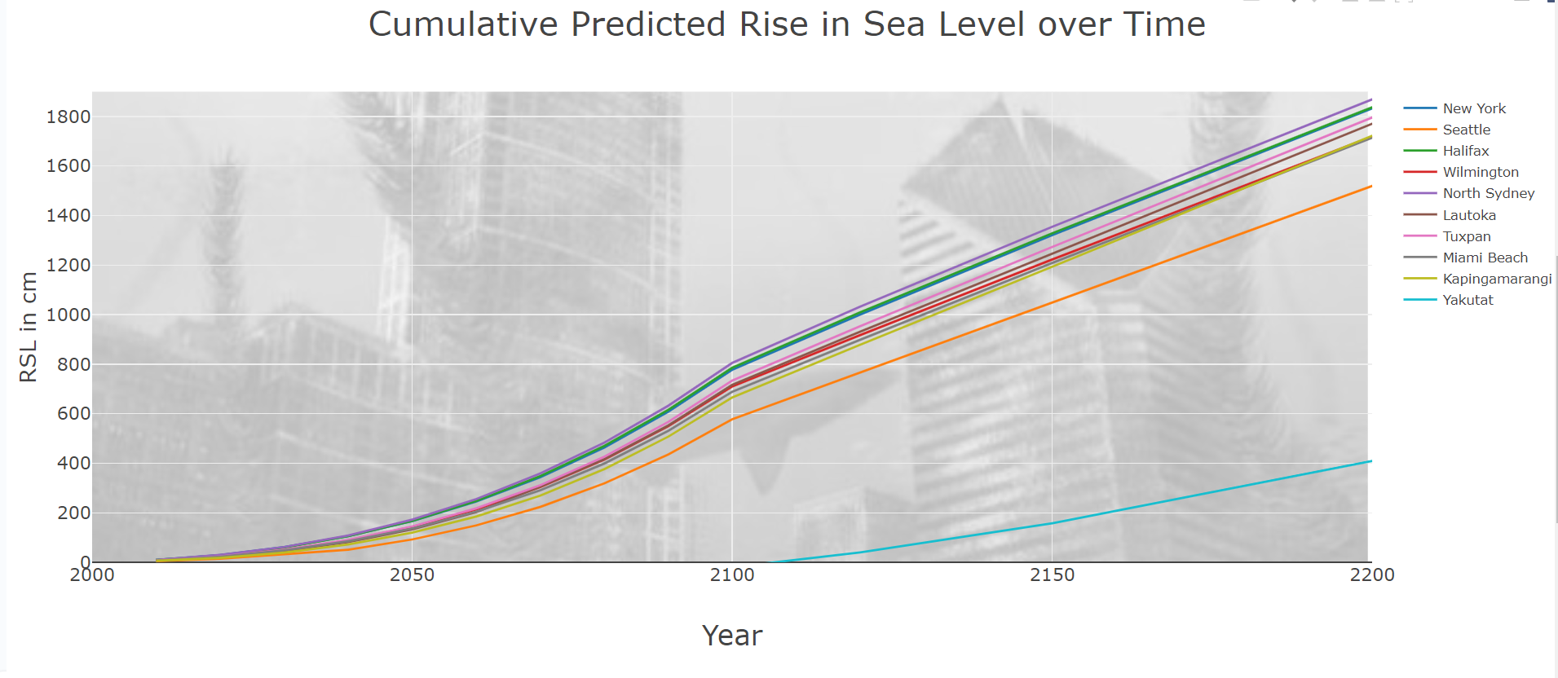
Predicted Sea Level Rise
Predictions:
2050
New York - 1.66 m
Sydney - 1.72 m
Miami Beach - 1.36 m
2100
New York - 7.77 m
Sydney - 8.05 m
Miami Beach - 6.88 m
Source: NOAA.gov
Notes:
RSL levels are influenced by:
Population density
Infrastructure
Availability of natural protection such as mangroves.
New York:Iconic coastal skyline at risk from flooding and storm surges.
Infrastructure vulnerabilities, including subways and utilities, susceptible to saltwater intrusion.
Sydney:
Sydney Opera House and harbor areas prone to inundation.
Vulnerability of coastal suburbs, transport systems, and cultural landmarks.
Miami Beach:
Extensive low-lying areas vulnerable to regular flooding.
Threats to real estate, tourism, and critical infrastructure.
Urgent need for adaptation strategies and mitigation efforts to address sea level rise.

Slide 10
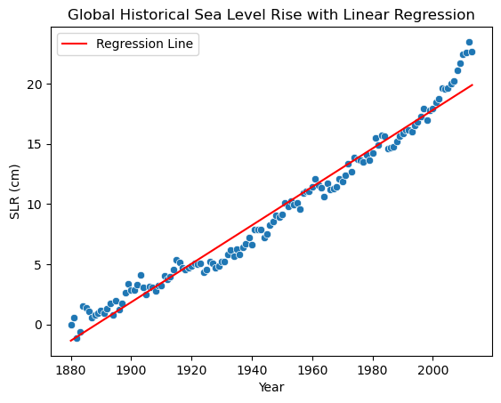
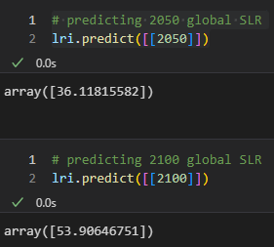
Predicted SLR Based on Historical Data
NASA Global SLR Predictions*:
2050: 30 cm
2010: 60 cm
Global SLR Predictions using Linear Regression model:
2050: 36.1 cm
2010: 53.9 cm
Independent variable = Year
Dependent variable = SLR in cm
*Source: NASA

Slide 11
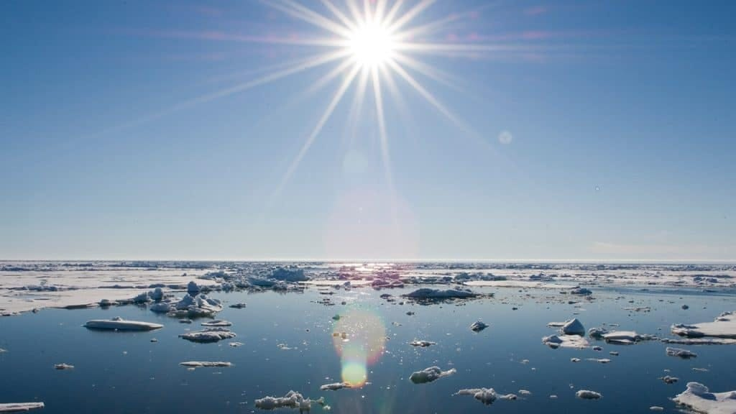
Global Ocean Temperatures
On average, our oceans have warmed at a rate of about 0.8C since pre-industrial times.*
Significant events in history have also contributed to these increased temperatures - events such as the COVID-19 pandemic and previous World Wars.
Overall, the past 3 decades have been significantly warmer than expected, compared to 1880 when reliable records began. *
*Source: https://www.carbonbrief.org

Slide 12
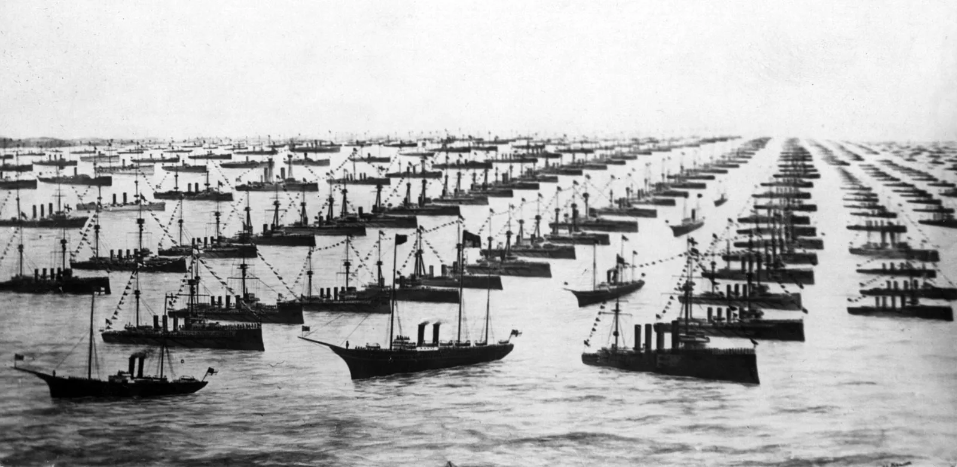
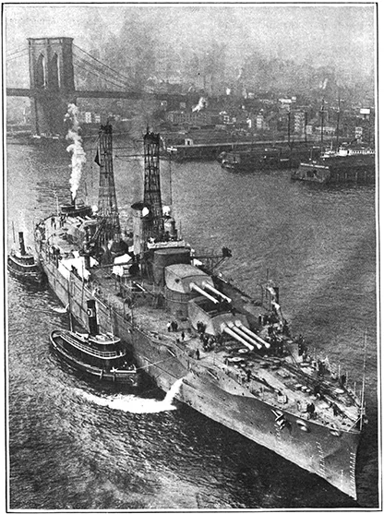
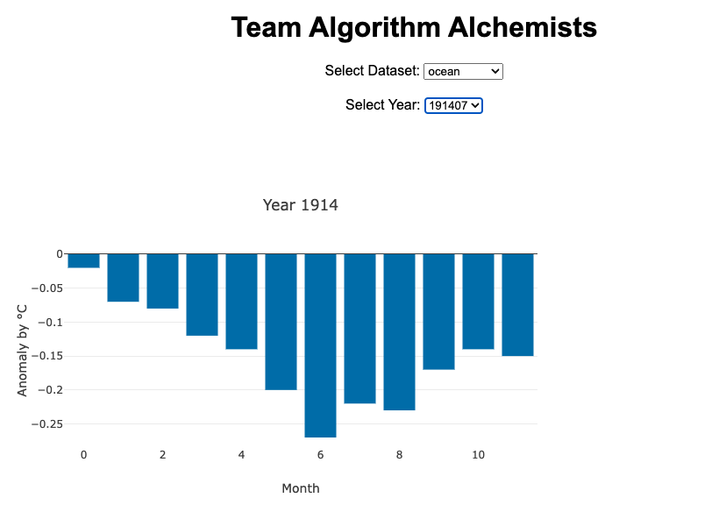
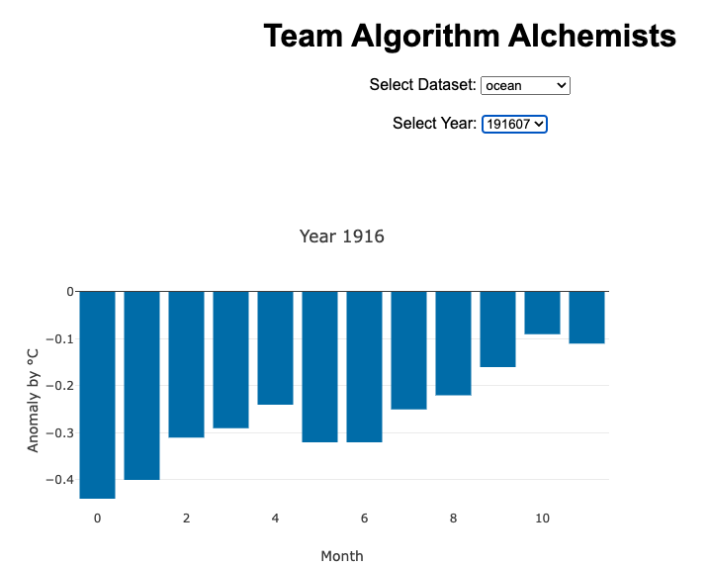
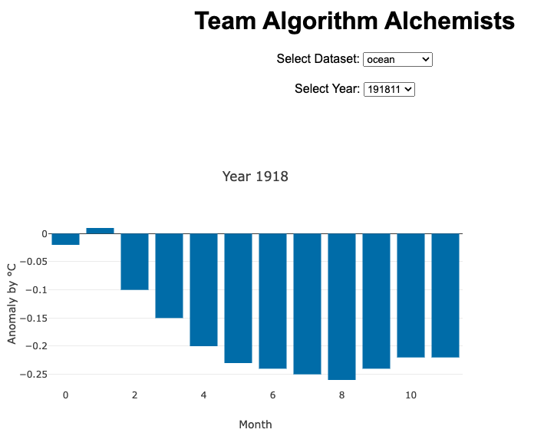
World War 1 - Visualized
World War 1: July 28, 1914 - November 11, 1918
While temperatures did rise slightly during the height of the war, the overall change was not drastic.

Slide 13
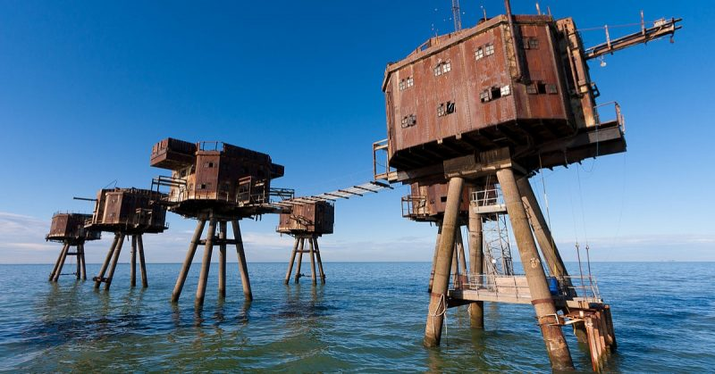
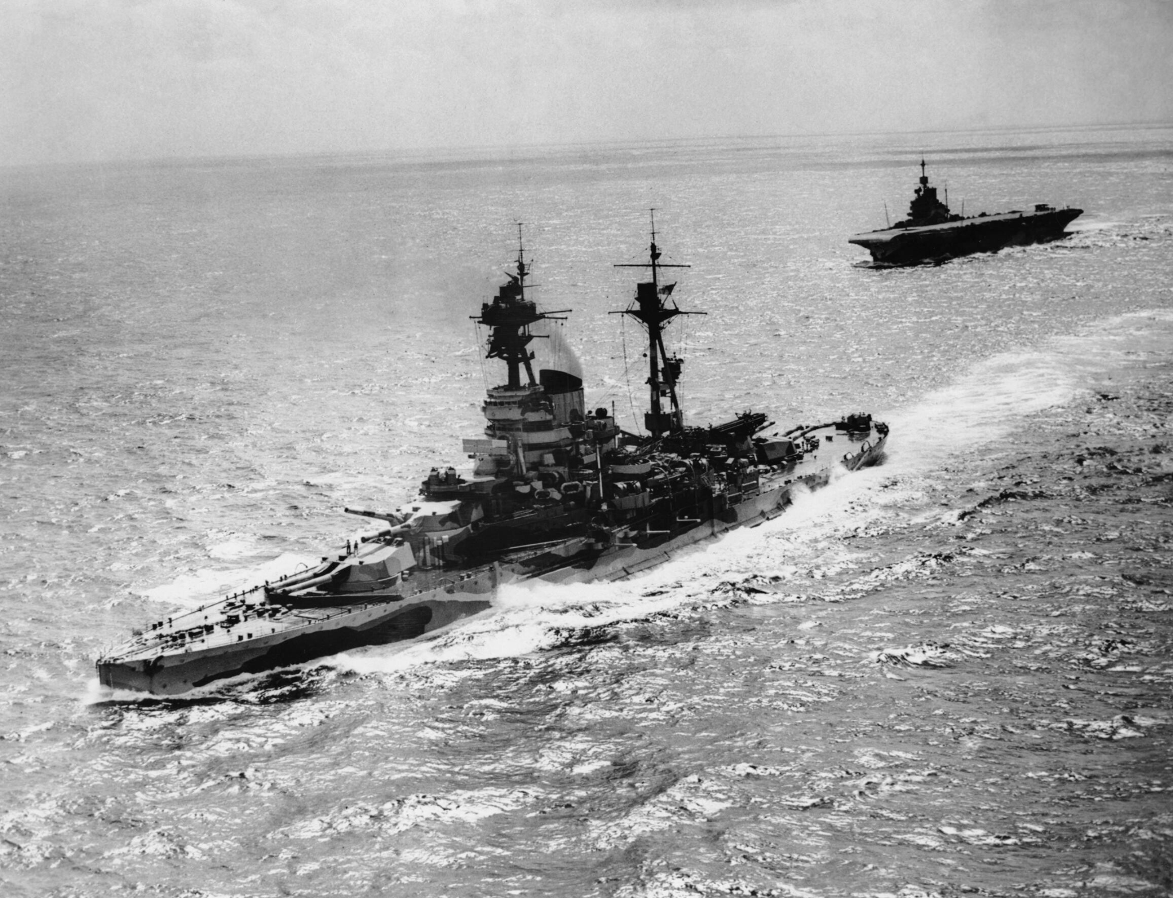
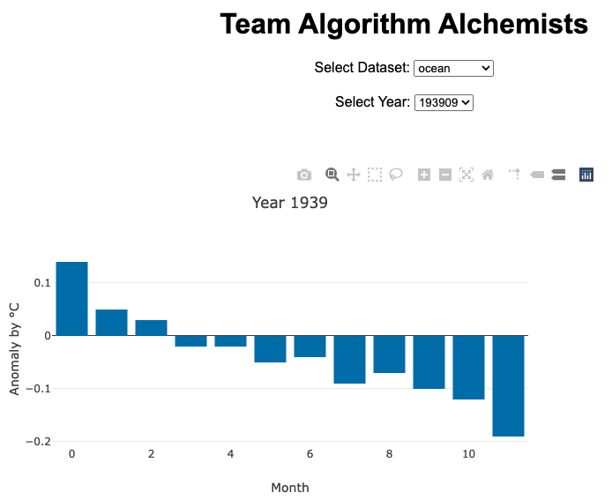
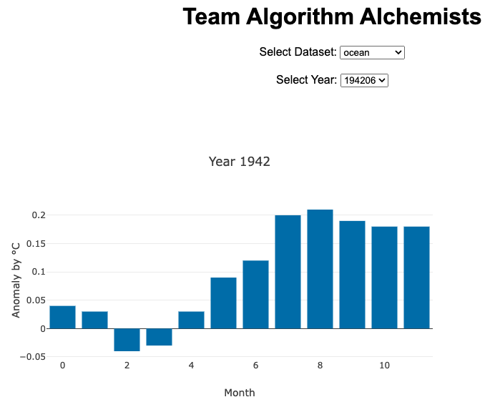
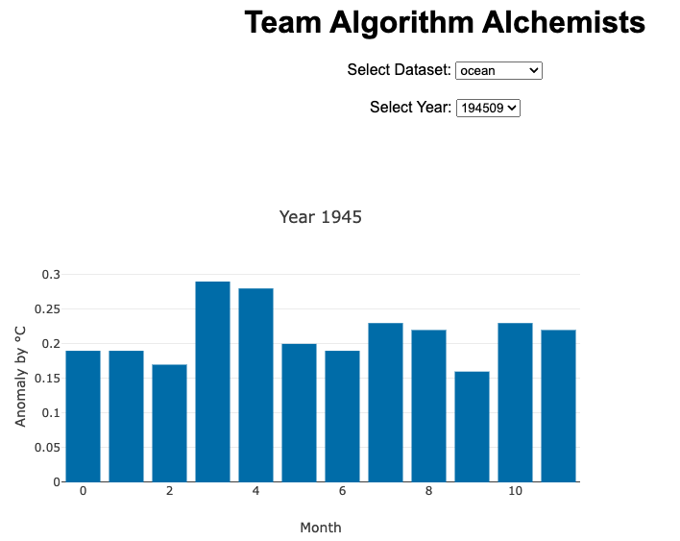
World War 2 - Visualized
World War 2: September 1, 1939 - September 2, 1945
The second World War, however, did see significant temperature increases.

Slide 14
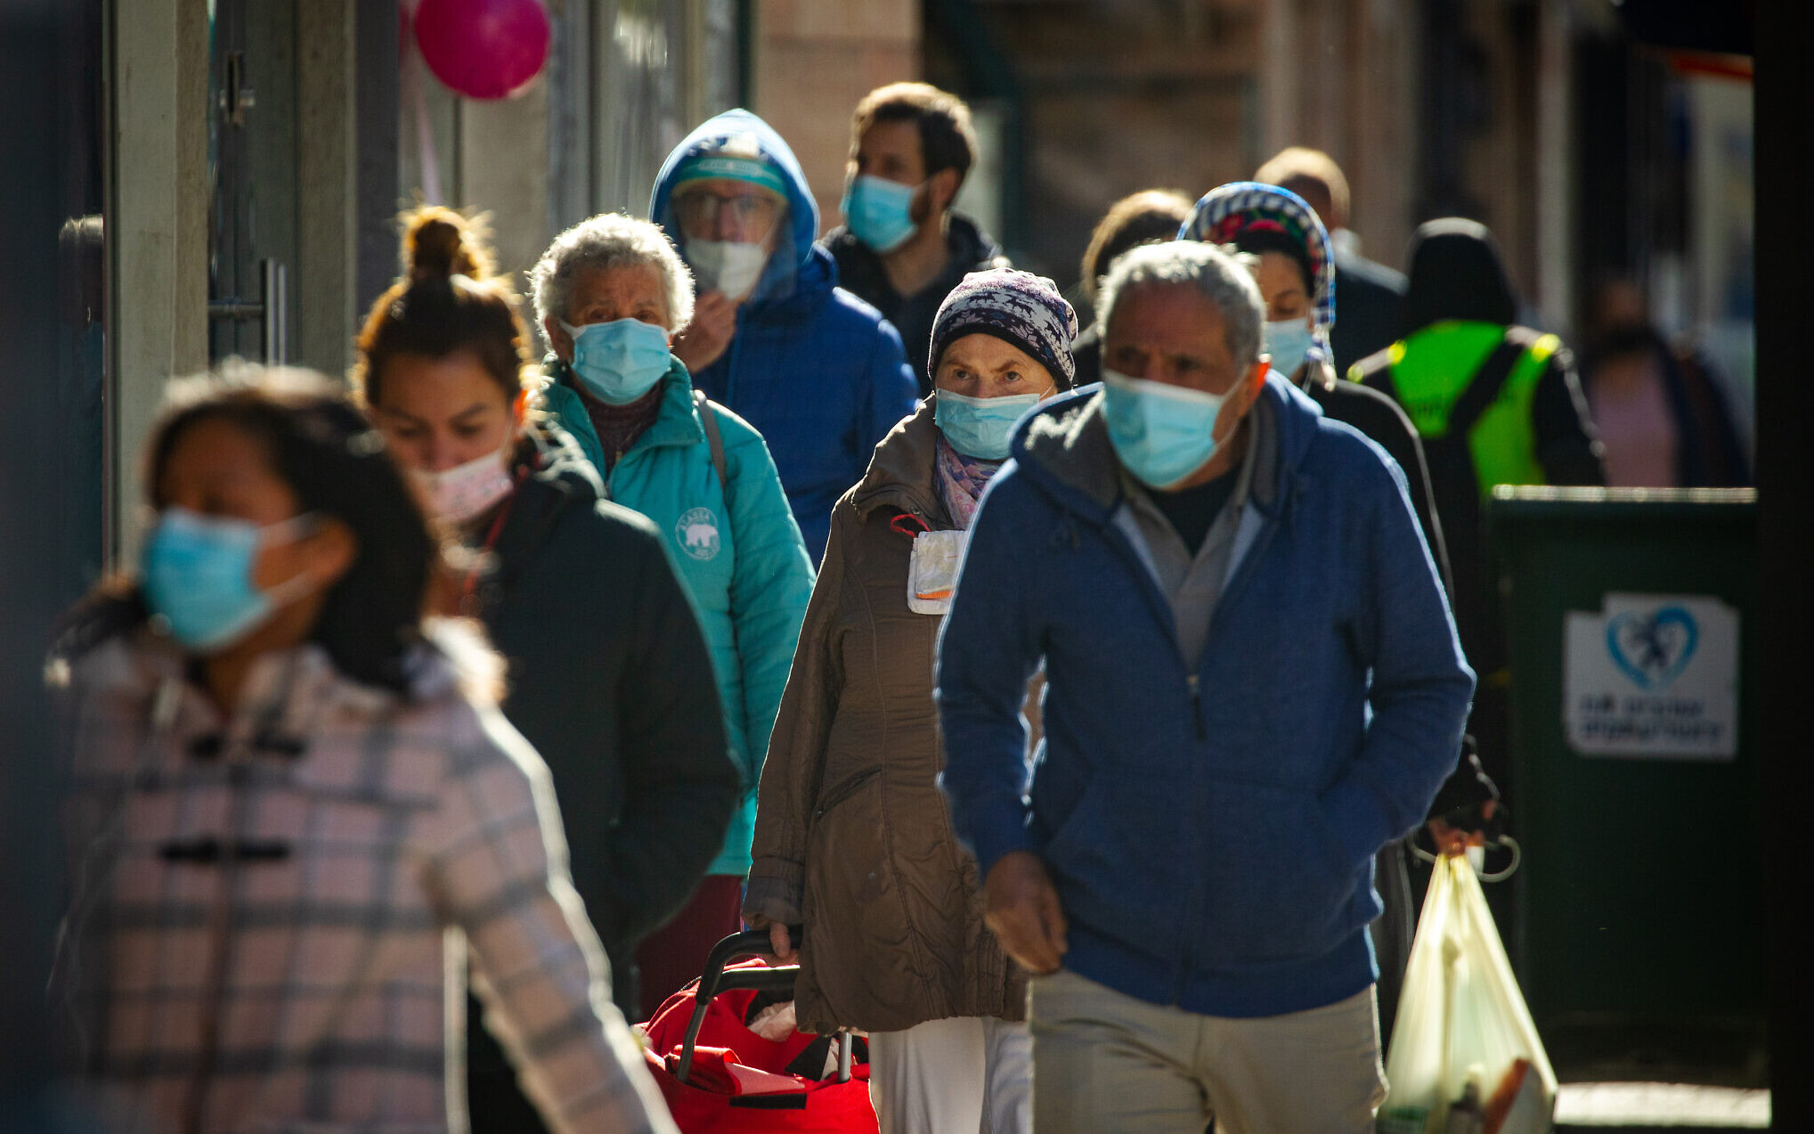
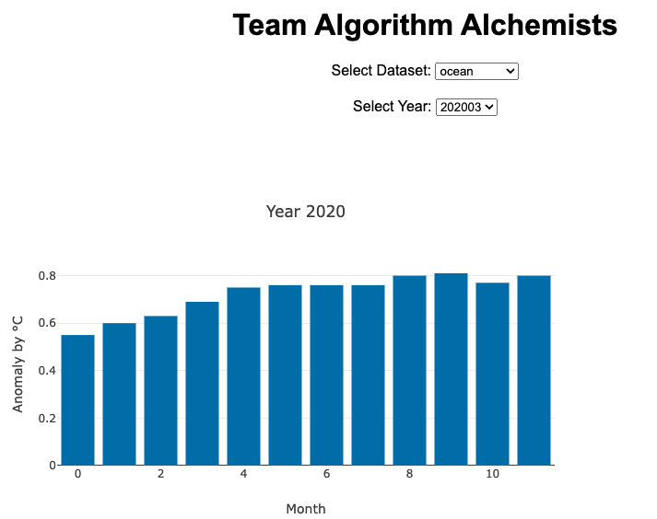
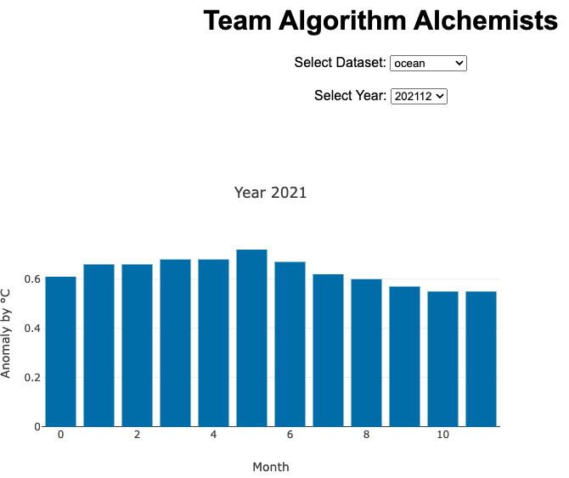
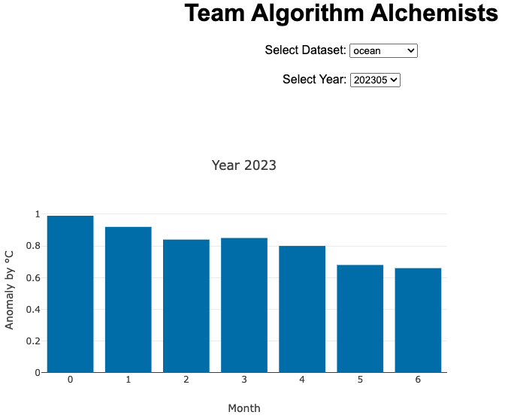
The COVID-19 Pandemic - Visualized
COVID-19 Pandemic: March 11, 2020 - May 5, 2023
Lasting impacts from the global shutdown significantly affected our ocean’s temperatures.

Slide 15
Air Quality

Slide 16
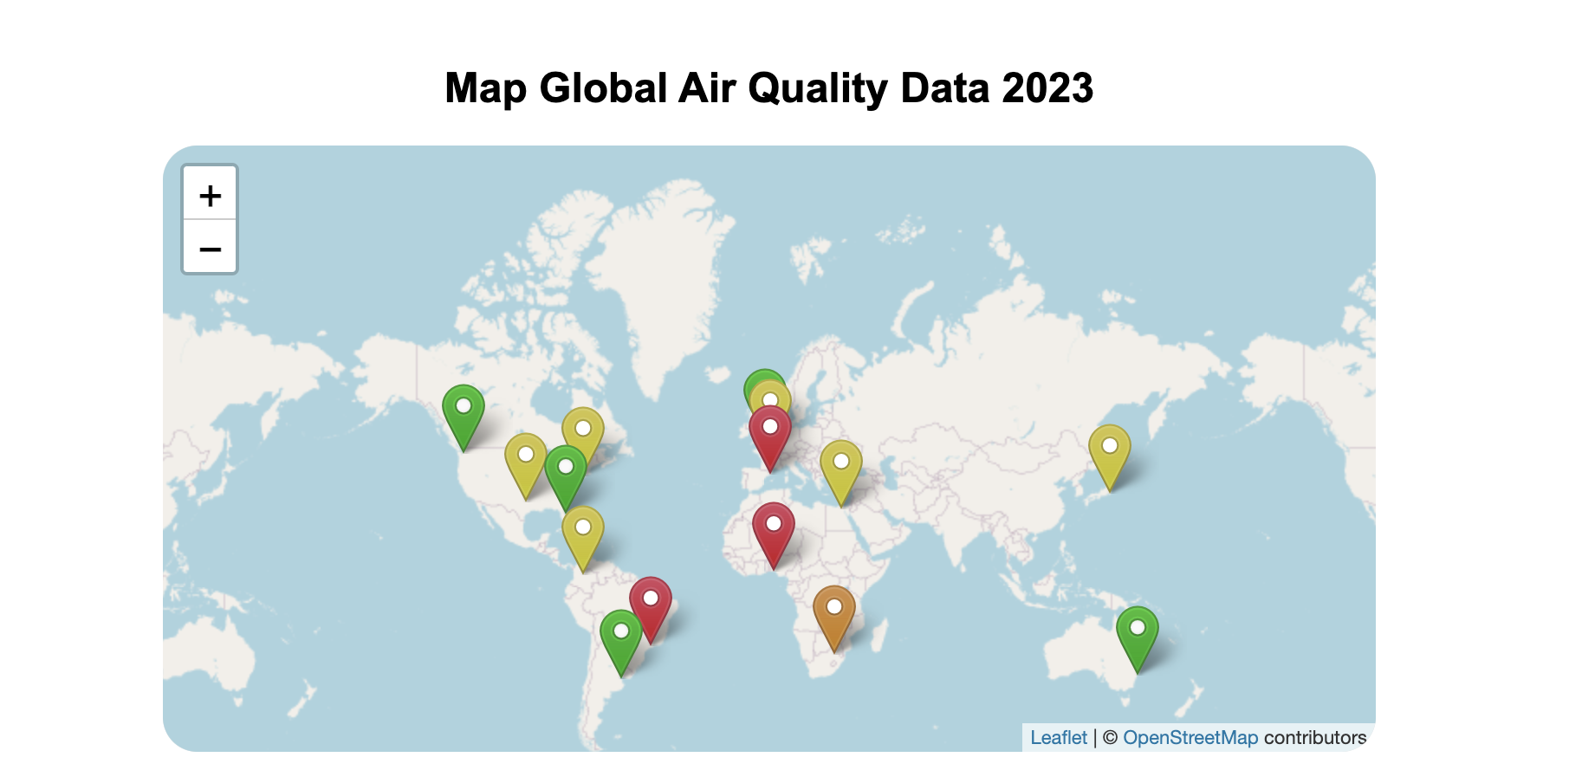
Air Quality
AQI Category + Value
General
CO
Ozone
NO2
pm2.5

Slide 17
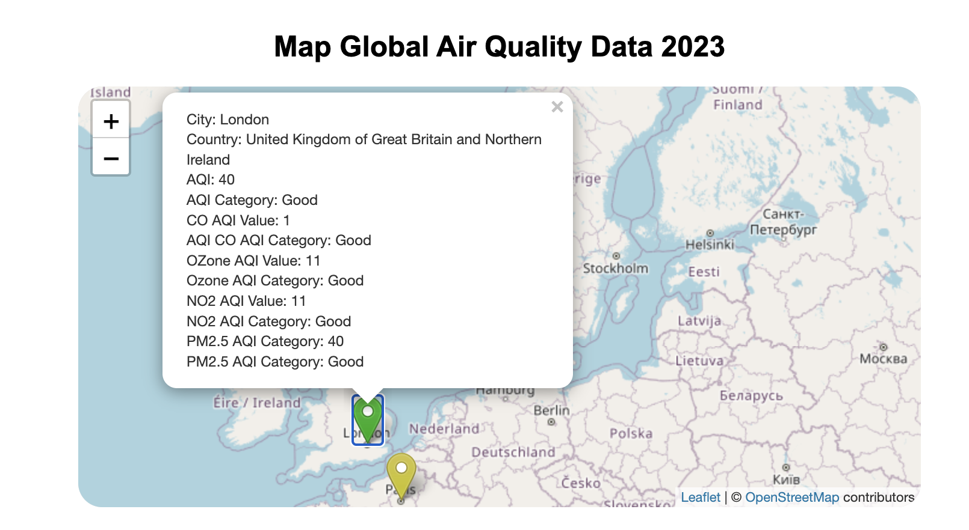
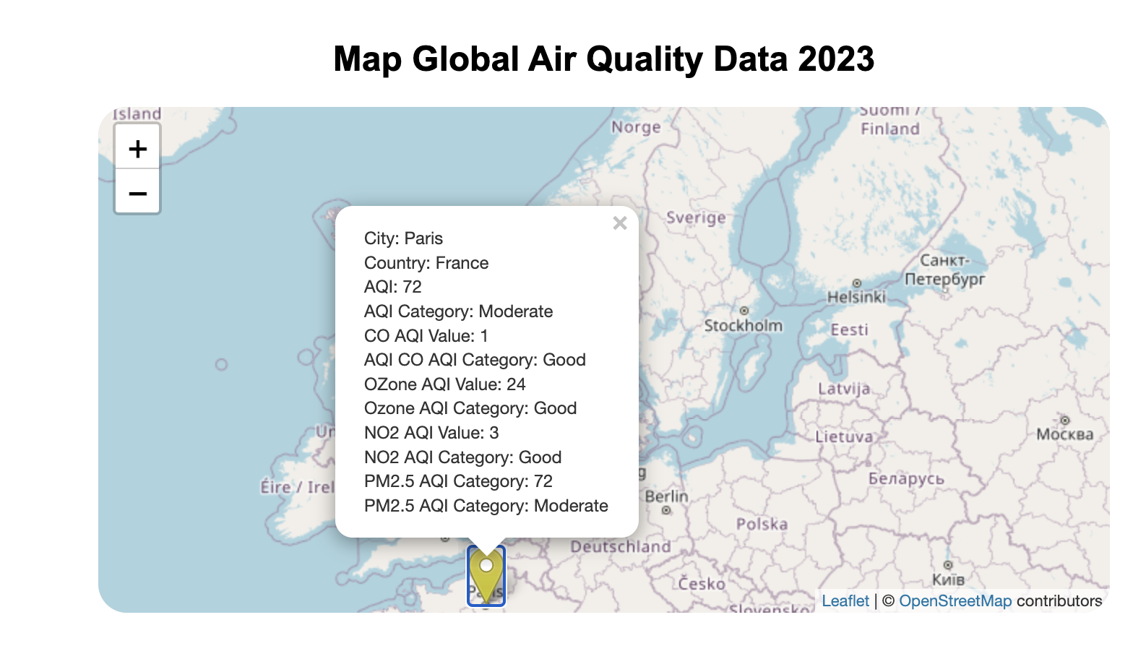
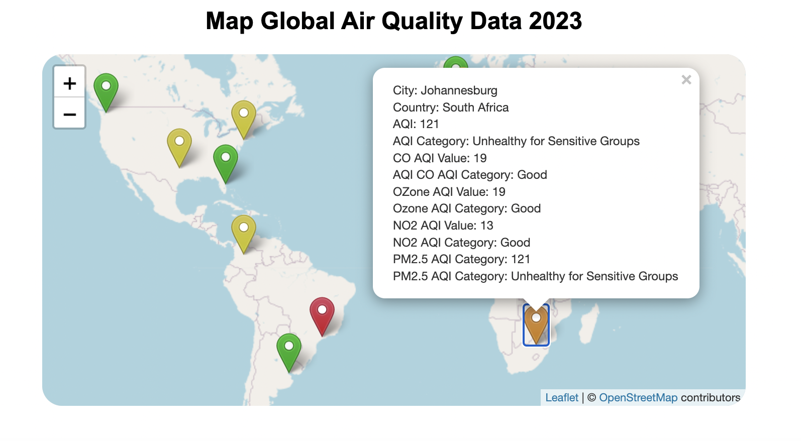
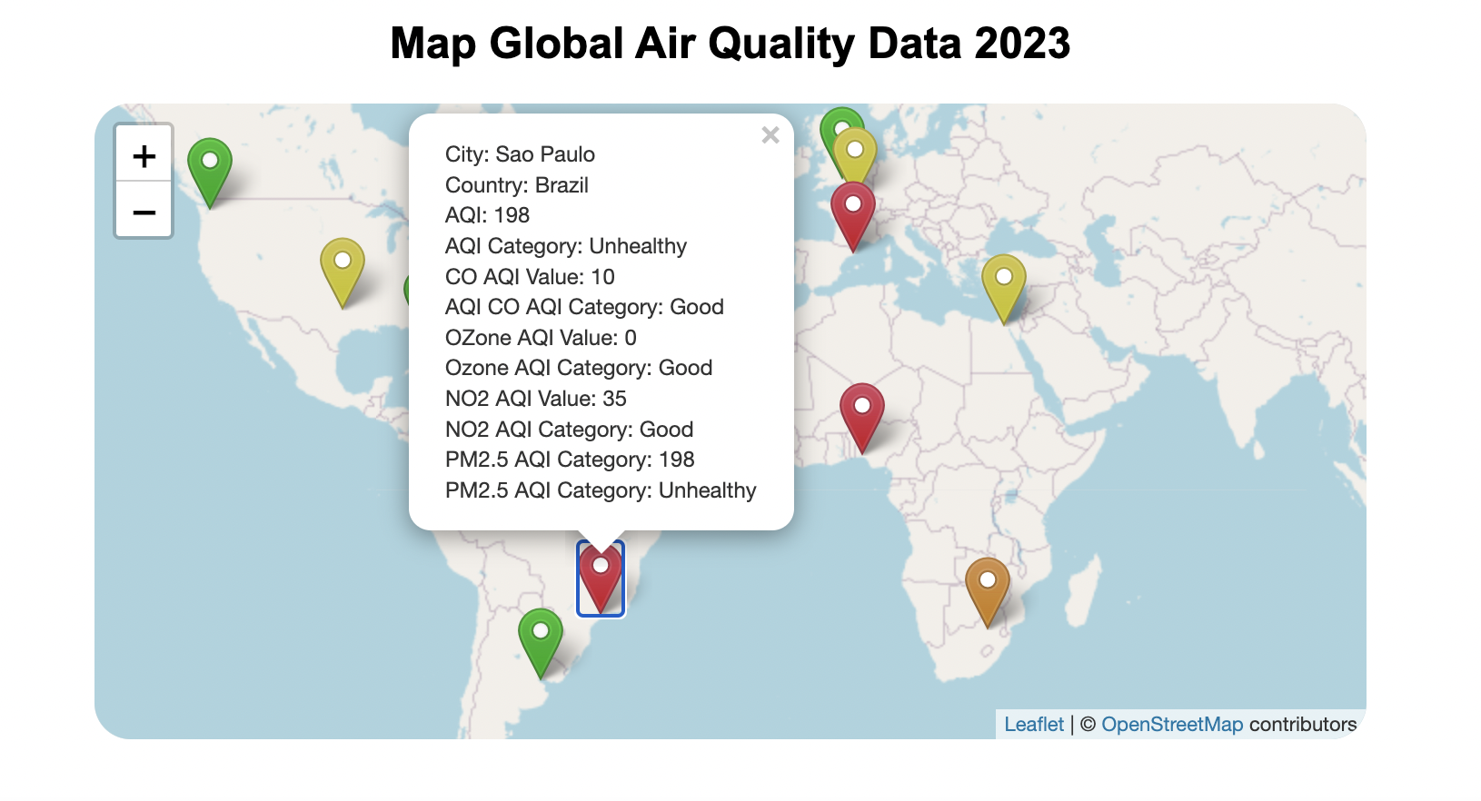

Slide 18
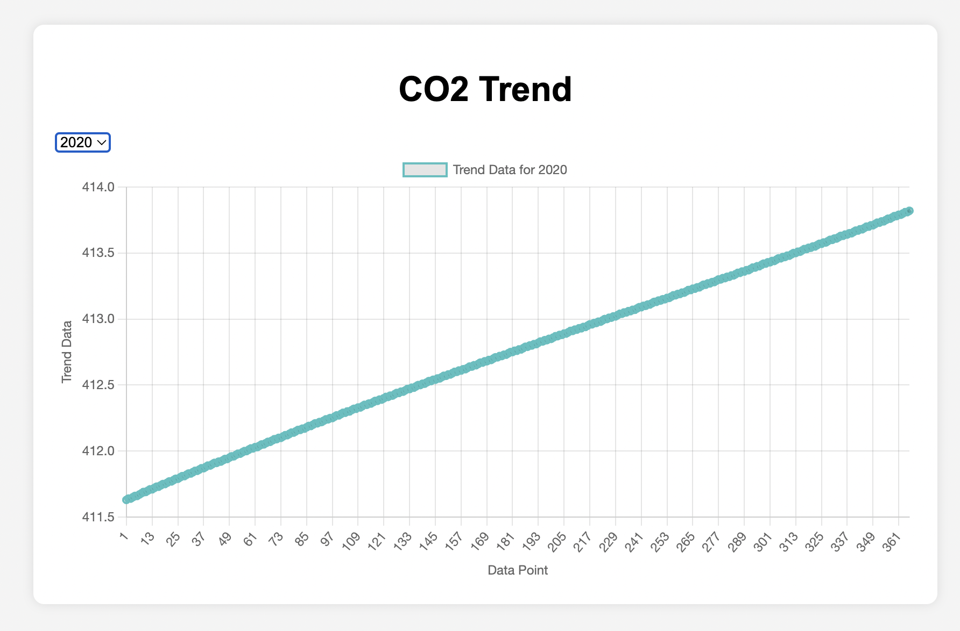
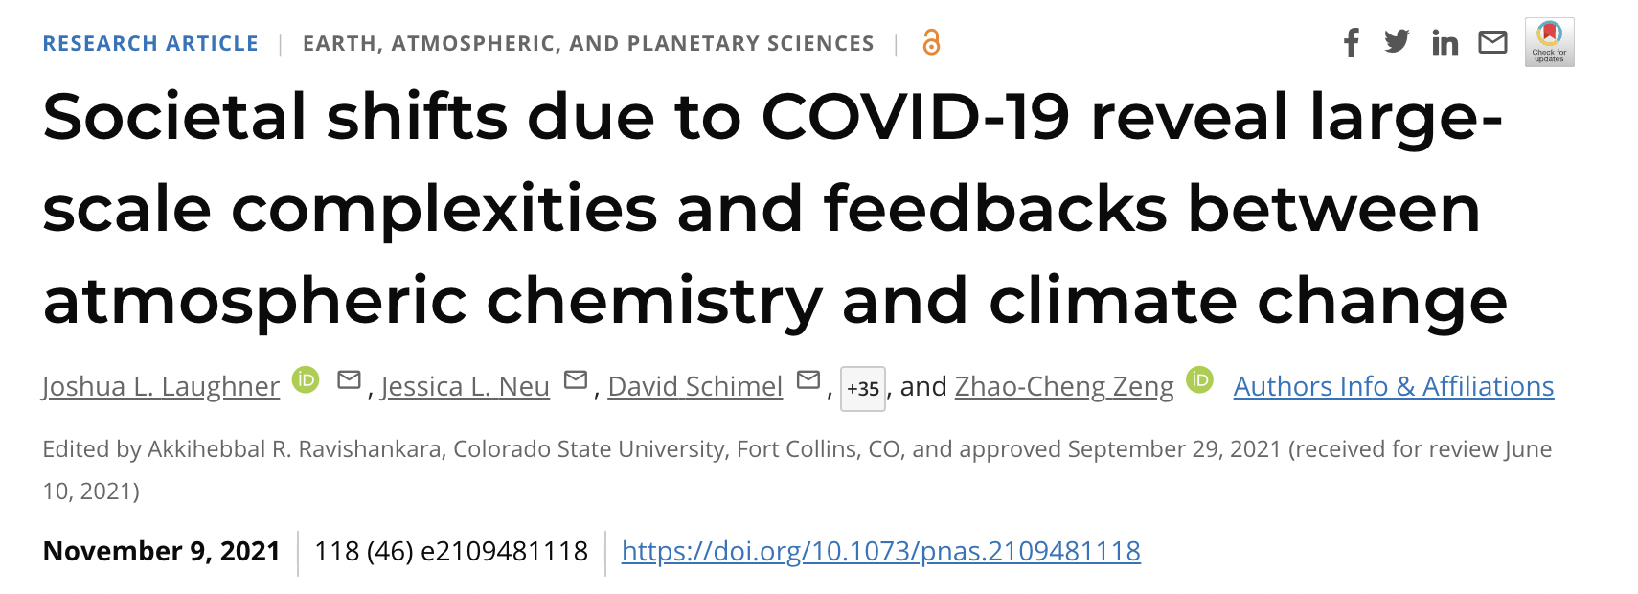
CO2 levels
Reference:
Pre-industrial levels 280 ppm
Today 420 ppm
Global Warming API
CO2 levels
2013-2023
Trend: 3 points per year
COVID did not slow down CO2 rising levels
However, while carbon dioxide (CO2) emissions fell by 5.4 percent in 2020 compared to the previous year, the amount of carbon dioxide in the atmosphere continued to grow at about the same rate as in preceding years. “This suggests that reducing activity in these industrial and residential sectors is not practical in the short term”.

Slide 19
Thank You

